Slide 1
YOU WILL BE A SERVANT
1 Kings 12

Slide 2
Key Verse - 1 Kings 12:7
They replied, “If today you will be a servant to these people and serve them and give them a favorable answer, they will always be your servants.”
Notes:
Today’s kv! We are living in a society where we value our individual happiness, self interests, own success & self esteem. One of law officers who defended the capital building against Jan 6 protestors pointed out, “we were treated as servants!” So being servant and humble could be the least & humiliating thing in our times. But it is not true in our blessed life in the Lord. The more we focus and exalt ourselves the more we are divided. But as we think others more and better, we will have a concern for their needs and serve them. Then it leads to a beautiful unity everywhere; a family, any organization, a nation and the world! If I consider you above me and you consider me above you, then a marvelous thing happens daily. We have a community of love.

Slide 3
Part 1: If today you will be a servant (1-15)
Part 2: They obeyed the word of the Lord (16-24)
Part 3: Jeroboam fortified northern kingdom (25-33)

Slide 4
Part 1
If today you will be a servant (1-15)
Notes:
In this 1st one, we will see what made Rehoboam to fail to keep his one nation.

Slide 5
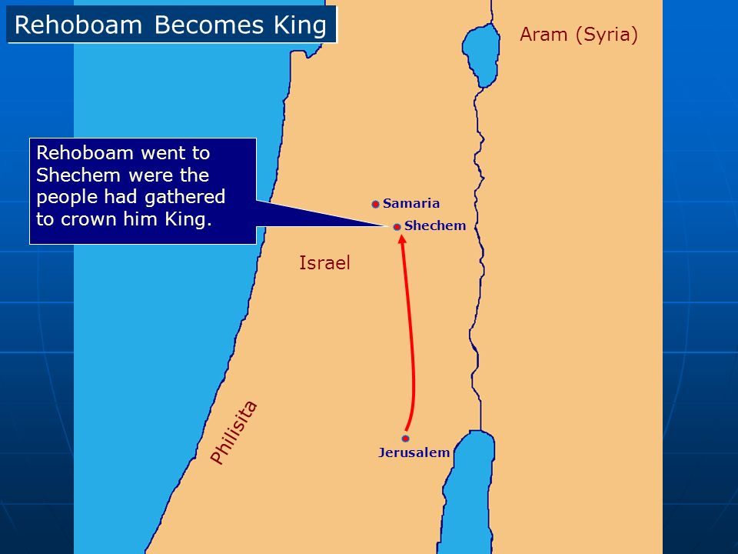
1 Kings 12:1
Rehoboam went to Shechem, for all Israel had gone there to make him king.
Notes:
Look at v 1. R! I have a question. Why should he go to Shechem? The city of David, Jerusalem should be the place to meet when he became a king? It was because all Israel had gone there to make him king instead of them going up to Jerusalem. In Israel history her unification was not easy at all.

Slide 6
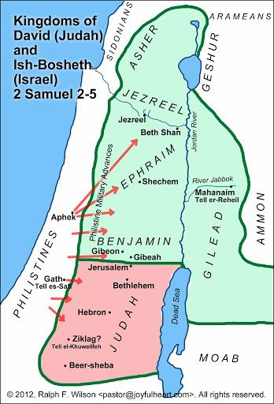
Notes:
For instance, David first reigned over the tribe of Judah for a while before he had to negotiate with northern tribes to making an unified nation. Likewise this time they want to do the same with his grandson rather than being loyal and serving him unconditionally.

Slide 7
1 Kings 12:2-4
When Jeroboam son of Nebat heard this (he was still in Egypt, where he had fled from King Solomon), he returned from Egypt. 3 So they sent for Jeroboam, and he and the whole assembly of Israel went to Rehoboam and said to him: 4 “Your father put a heavy yoke on us, but now lighten the harsh labor and the heavy yoke he put on us, and we will serve you.”
Notes:
Look at v2-4. R! From the previous passage, Solomon tried to kill Jeroboam, but he fled to Egypt, and stayed there until Solomon’s death. Now he returned and became a representative for the Israel. Then he went to Rehoboam by saying, “But now lighten the harsh labor and the heavy yoke he put on us, and we will serve you.” Here, they complained about the last leader. They did not complain about his father’s idol worship. Rather what was important to them was that they might live at ease with less labor and pay lower taxes. In our times, people are also talking about unemployment, economy and higher tax. People are more interested in serving their own interests and seemingly urgent issues rather than their relationship with God..

Slide 8
1 Kings 12:5
Rehoboam answered, “Go away for three days and then come back to me.” So the people went away.
Notes:
R! He asked more time to think about it. What would be the next for him at such a limited time? First he could have humbled himself and prayed to seek God and His will. Why? It is because He is the Wonderful Counselor. (Isa 9:6) But he did not inquire of the Lord in this matter. He also should have opened the book of Moses. Whenever we have difficulty, we must turn our attention to the living word until one word comes to our heart as a morning star! Right?

Slide 9
Deuteronomy 17:19-20
It is to be with him, and he is to read it all the days of his life so that he may learn to revere the Lord his God and follow carefully all the words of this law and these decrees and not consider himself better than his fellow Israelites and turn from the law to the right or to the left. Then he and his descendants will reign a long time over his kingdom in Israel.
Notes:
Deut. 17:19-20 reads! Here is Godly wisdom to maintain his kingdom for a long time. First, king must read the words of God to revere the Lord and carefully obey Him. With the fear of God, he does not need to fear nothing else. But if he does not fear God, he would fear everything else. Secondly, he must not consider himself better than his fellow Israelites. Then his kingdom will secure and sustain long time as he applied God’s words to him. My point is, a wonderful advice is already in the word of God!

Slide 10
1 Kings 12:6
Then King Rehoboam consulted the elders who had served his father Solomon during his lifetime. “How would you advise me to answer these people?” he asked.
Notes:
R! When he did not know how to rely on God in prayer and in the word personally, he consulted the elders who had served his father during his lifetime. At least he chose the second best option, still very good option in seeking good and wise advice from the elders. Now God used them to help him out. What was their advice for him?

Slide 11
1 Kings 12:7
They replied, “If today you will be a servant to these people and serve them and give them a favorable answer, they will always be your servants.”
Notes:
They advised him by saying, “If today you will be a servant to these people and serve them and give them a favorable answer, they will always be your servants” The words, “servant” and “serve” repeated 3 times. These elders used to support the wisest king, Solomon during his lifetime. They knew how to counsel him with their experience with his father. So he should have listened to them. It was based on servant leadership. They told him to embrace any criticism, give a kind answer as a good servant. Then he would win their hearts over. In other words, “Deny yourself, listen to them carefully and serve them and the people would be your servants.”

Slide 12
1 Kings 3:7-9
“Now, Lord my God, you have made your servant king in place of my father David. But I am only a little child and do not know how to carry out my duties. 8 Your servant is here among the people you have chosen, a great people, too numerous to count or number. 9 So give your servant a discerning heart to govern your people and to distinguish between right and wrong. For who is able to govern this great people of yours?”
Notes:
In ch 3, Solomon identified himself as a humble servant of God’s great people. He asked for wisdom in order that he may serve them well. God was so pleased with him that he was given wisdom and other blessings. Then in the beginning of his reign all God’s people were willing to be his servants because they were given favorable answers with God given wisdom to Solomon. Then he and the people were very happy and satisfied, serving God joyfully together.

Slide 13
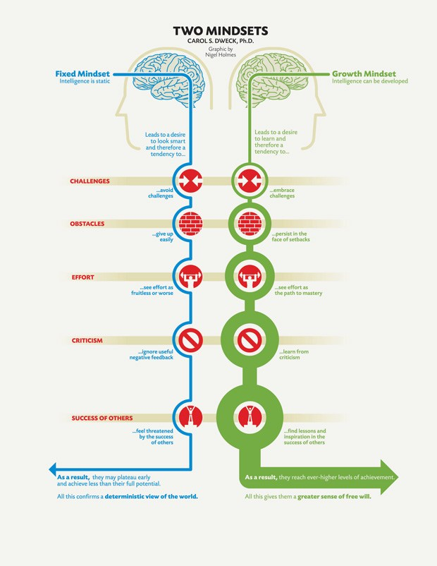
“Fixed Mindset” vs “Growth Mindset”
Notes:
Also, servant leadership has to do with growth mindset. It makes one to have desire for learning rather than wasting time to prove how great you are, and holding a hunger for approval like fixed mindset. Even love and friendship can be earned, challenged, , & cultivated through effort and deliberate practice. Those who have such growing mindset do not give up by criticism or failure, rather they actually see them as learning to stretch themselves and improve. Then they will gain more people! This is the mindset that could allow Rehoboam to thrive at a critical time!

Slide 14
1 Corinthians 9:19-23
Though I am free and belong to no one, I have made myself a slave to everyone, to win as many as possible. 20 To the Jews I became like a Jew, to win the Jews...To the weak I became weak, to win the weak. I have become all things to all people so that by all possible means I might save some. 23 I do all this for the sake of the gospel, that I may share in its blessings.
Notes:
So the proper way to rule is to serve, to do good, to become all things to all men and so win their hearts. Ap. Paul said in 1 Cor 9. R! He was not aiming to be served, approved or rewarded from others, rather he embraced many different people, love them, and serve them to save them as many as possible. In this way he earned others’ hearts with learning mindset, serving leadership and stretching leadership.

Slide 15
1 Kings 12:8-11
But Rehoboam rejected the advice the elders gave him and consulted the young men who had grown up with him and were serving him. 9 He asked them, “What is your advice? How should we answer these people who say to me, ‘Lighten the yoke your father put on us’?”
10 The young men who had grown up with him replied, “These people have said to you, ‘Your father put a heavy yoke on us, but make our yoke lighter.’ Now tell them, ‘My little finger is thicker than my father’s waist. 11 My father laid on you a heavy yoke; I will make it even heavier. My father scourged you with whips; I will scourge you with scorpions.’”
Notes:
R! Rehoboam rejected the servantship advice the elders gave him. Now he consulted the young men who used to be his growing buddies. They encouraged him to exercise his authority. Like him, they were young, ambitious, proud, and insecure. They prefer top down, bully, and authoritative style leadership to(over) servant leadership. Rehoboam who took his friends’ advice wanted to be in control, He viewed mercy, kindness, and humility as weakness. He thought that a show of strength with threats was a far better response to the people’s request.

Slide 16
1 Kings 12:12-14
Three days later Jeroboam and all the people returned to Rehoboam, as the king had said, “Come back to me in three days.” 13 The king answered the people harshly. Rejecting the advice given him by the elders, 14 he followed the advice of the young men and said, “My father made your yoke heavy; I will make it even heavier. My father scourged you with whips; I will scourge you with scorpions.”
Notes:
R! Here he chose to follow the advice of the young men. He also made mistakes that he accepted the people’s comments about his father and thus tarnished his father’s legacy. He could have pointed out all the good things that his father had done for them. Then he foolishly threatens them by saying that he would not only tax them more, but whip them harder. Here he considered himself better than his father who was the wisest man. He was driven by his groundless pride.

Slide 17
1 Kings 12:15
So the king did not listen to the people, for this turn of events was from the Lord, to fulfill the word the Lord had spoken to Jeroboam son of Nebat through Ahijah the Shilonite.
Notes:
R! The author of this book commented here by saying that for this turn of events was from the Lord, to fulfill the word the Lord had spoken to Jeroboam through his servant. What happened was that God let him do whatever he wanted by honoring his will and free choice. God left him to his own folly, and hid from his eyes, the things that were right. God even serves his own righteous purpose by the sinful men, and snares sinners in the work of their own. But God’s Sovereign will prospered.

Slide 18
Part 2
They obeyed the word of the Lord (16-24)
Notes:
In this part, Rehoboam could have saved his kingdom if he had repented of his pride and resumed servant leadership. There was a window of opportunity for healing and reconciliation. But he could not reverse the course.

Slide 19
1 Kings 12:16-17
When all Israel saw that the king refused to listen to them, they answered the king: “What share do we have in David, what part in Jesse’s son? To your tents, Israel! Look after your own house, David!” So the Israelites went home. 17 But as for the Israelites who were living in the towns of Judah, Rehoboam still ruled over them.
Notes:
R! As a result of Rehoboam’s unwise move, all northern tribes were not satisfied with him. He was barely able to rule over the towns of Judah only. What a tragedy! He went up to Shechem to confirm his kingship from northern tribes but he was about to lose them all!

Slide 20
1 Kings 12:18-20
King Rehoboam sent out Adoniram, who was in charge of forced labor, but all Israel stoned him to death. King Rehoboam, however, managed to get into his chariot and escape to Jerusalem. 19 So Israel has been in rebellion against the house of David to this day. 20 When all the Israelites heard that Jeroboam had returned, they sent and called him to the assembly and made him king over all Israel. Only the tribe of Judah remained loyal to the house of David.
Notes:
R! Here is another critical mistake of Rehoboam to make the situation get worse. He sent out Adoniram who used to be in charge of forced labor. He was already the very object of hatred. All Israel stoned him to death immediately and king Rehoboam barely escaped the place. Now Israel burned the bridge behind by making Jeroboam a king over all Israel. Only the tribe of Judah remained loyal to the house of David.

Slide 21
1 Kings 12:21
When Rehoboam arrived in Jerusalem, he mustered all Judah and the tribe of Benjamin—a hundred and eighty thousand able young men—to go to war against Israel and to regain the kingdom for Rehoboam son of Solomon.
Notes:
Now it was on the verge of civil war among the Israelites. 180,000 able young men were ready to go to war. But God intervened through His servant.

Slide 22
1 Kings 12:22-24
But this word of God came to Shemaiah the man of God: 23 “Say to Rehoboam son of Solomon king of Judah, to all Judah and Benjamin, and to the rest of the people, 24 ‘This is what the Lord says: Do not go up to fight against your brothers, the Israelites. Go home, every one of you, for this is my doing.’” So they obeyed the word of the Lord and went home again, as the Lord had ordered.
Notes:
R! But thankfully this critical time, the word of God came to Shemaiah the man of God and let him serve those who are blind. Thankfully they obeyed the word of the Lord this time and went home. We could see here the hope of the southern kingdom because they denied themselves and obeyed God. Then they served God’s purpose. Despite Rehoboam’s foolishness so far, at least he listened to God’s servant and saved many lives. Praise the Sovereign Lord!

Slide 23
Part 3
Jeroboam fortified northern kingdom (25-33)
Notes:
In this last part, the author shifted his focus from Rehoboam to Jeroboam and how he established his new kingdom, Israel.

Slide 24
1 Kings 11:38
If you do whatever I command you and walk in obedience to me and do what is right in my eyes by obeying my decrees and commands, as David my servant did, I will be with you...
Notes:
Let us remember chp 11 about what was the will of God for Jeroboam when he would become a king over Israel. R! He became a king not because he was a popular man, rather he was a holy instrument of God to fulfill His will. Then he must humble himself as God’s servant and trust in the Lord and must DO whatever God commanded him and walk in obedience to God as David did. But he ignored God’s instructions and served his own interest. Out of great fear, he committed great sins.

Slide 25
1 Kings 12:25-27
Then Jeroboam fortified Shechem in the hill country of Ephraim and lived there. From there he went out and built up Peniel. 26 Jeroboam thought to himself, “The kingdom will now likely revert to the house of David. 27 If these people go up to offer sacrifices at the temple of the Lord in Jerusalem, they will again give their allegiance to their lord, Rehoboam king of Judah. They will kill me and return to King Rehoboam.”
Notes:
R! First Jeroboam fortified Shechem and built up Peniel at the other side of Jordan. Instead of having his people serve God faithfully, he was more concerned about how to make his people stay in his territory to serve him as a new king. So out of fear and his own thought process, he planned to secure his own kingdom by altering several things to his convenience instead of trusting and obeying God as it is written!

Slide 26
1 Kings 12:28-29
After seeking advice, the king made two golden calves. He said to the people, “It is too much for you to go up to Jerusalem. Here are your gods, Israel, who brought you up out of Egypt.” 29 One he set up in Bethel, and the other in Dan. 30 And this thing became a sin; the people came to worship the one at Bethel and went as far as Dan to worship the other.
Notes:
R! He sought after wrong advice. Rather he should have asked God and hold God’s word of promise and trust him fully. But after seeking advice, he made 2 golden calves and convinced the people by saying, “it is too much for you guys to go to Jerusalem. Here are your gods, Israel.”One he set up in Bethel, and the other in Dan. This thing became a terrible sin against God because they came to worship idols.

Slide 27
1 Kings 12:29-33
Jeroboam built shrines on high places and appointed priests from all sorts of people, even though they were not Levites. 32 He instituted a festival on the fifteenth day of the eighth month, like the festival held in Judah, and offered sacrifices on the altar. This he did in Bethel, sacrificing to the calves he had made. And at Bethel he also installed priests at the high places he had made. 33 On the fifteenth day of the eighth month, a month of his own choosing, he offered sacrifices on the altar he had built at Bethel. So he instituted the festival for the Israelites and went up to the altar to make offerings.
Notes:
What was worse, he built shrines on high places and appointed priests from all sorts of people. They were not Levites though. He instituted a festival on the 8th month instead of 7th month according to God’s word. Even he himself offered sacrifices on the altar at Bethel. He completely ignored God’s commands and willfully disobeyed God.

Slide 28
2 Chronicles 11:14 & 16
The Levites even abandoned their pasturelands and property and came to Judah and Jerusalem, because Jeroboam and his sons had rejected them as priests of the Lord. Those from every tribe of Israel who set their hearts on seeking the Lord, the God of Israel, followed the Levites to Jerusalem to offer sacrifices to the Lord, the God of their ancestors.
Notes:
2 Chr 11 R! In the midst of spiritual crisis in northern kingdom, still there were God’s remnants. When Northern Israel people compromised with idol worship, those who really desired to worship God in the right way abandoned their property and came to Judah. It was their priority to serve God no matter how much they lost. Praise God who preserve His holy servants!

Slide 29
Solomon
Rehoboam
Jeroboam
Notes:
So far none of these 3 kings were faithful to the end. Solomon served idols without repentance. Rehoboam was too proud to serve God’s people humbly. Jeroboam served counterfeit god out of fear. They were trapped/enslaved by their invisible enemies who came only to steal, kill, and destroy them and divide their nation. They were supposed to pray, repent, trust and be humble before God, and listen to God. Although these kings failed, but God never fails to keep His promise given to David. He raised up His true servant. Who is it?

Slide 30
Jesus =
The Holy Servant
Notes:
Jesus! Jesus is the Holy Servant. Although he is the Son of God, he learned obedience from what he suffered. He is the perfect example for us. He is faithful always. He trusted & prayed before God. He serves us every day through His truth, genuine love, compassion, sacrificial care, guidance, and intercession until we are transformed into His servants. This is & has been our greatest blessing to complete God’s work initiated in each of us. So we are joyfully saying, we are His servants!

Slide 31
Matthew 11:27b
“No one knows the Son except the Father, and no one knows the Father except the Son and those to whom the Son chooses to reveal him.”
Notes:
Matt 11:27 reads! The Son knows the Father, and God the Father knows the Son because they are equal in nature. But we can know God the Father only through Jesus who made Himself known to us. “Those to whom the Son chooses to reveal him!” How THEN did he reveal Himself to us?

Slide 32
Philippians 2:6-8
Who, being in very nature God, did not consider equality with God something to be used to his own advantage; rather, he made himself nothing by taking the very nature of a servant, being made in human likeness. And being found in appearance as a man, he humbled himself by becoming obedient to death—even death on a cross!
Notes:
Php 2! Jesus, being in very nature God did not consider equality with God something to be used to his own advantage; rather, he made himself nothing by taking the very nature of a servant, being in human likeness. And being found in appearance as a man, he humbled himself by becoming obedient to death - even death on a cross. In this way JESUS clearly revealed Himself to us as our true Servant!

Slide 33
John 12:24
Very truly I tell you, unless a kernel of wheat falls to the ground and dies, it remains only a single seed. But if it dies, it produces many seeds.
Notes:
Praise Jesus who became a kernel of wheat falls to the ground and suffers & dies, and produced many seeds. Likewise today we have a vision to live a life of abundance in Christ!

Slide 34
Mark 10:45
For even the Son of Man did not come to be served, but to serve, and to give his life as a ransom for many.”
Notes:
Jesus said, “For even the Son of Man did not come to be served, but to serve, and to give his life as a ransom for many.” Jesus, though He is the Son of God and the Sovereign God, did not to come to be served, but to serve and give his life as a ransom for many.

Slide 35
John 12:26
Whoever serves me must follow me; and where I am, my servant also will be. My Father will honor the one who serves me.
Notes:
R! To be a Christian is to serve Jesus, to follow Him and His exemplary life. We are not forced but we are willing to be His followers. The reward for serving Jesus is to receive honor from our Heavenly Father. This is the greatest honor that this world has ever known! So here following Jesus is to serve others as He did for us. Jesus said in Jn 13:15, I have set you an example that you should do as I have done for you. Today it is up to our choice either to be served or to serve. When we want to be served, we will have grievance, grudge & complaints. But when we want to serve as His servants, we will overcome all misunderstandings and love each other deeply. Then such genuine love covers a multitude of our sins and we will have a beautiful unity of love!

Slide 36
Ephesians 4:2-3
Be completely humble and gentle; be patient, bearing with one another in love. Make every effort to keep the unity of the Spirit through the bond of peace.
Notes:
R! “Be completely humble...” With this wisdom, we submit to one another out of reverence for Christ like between husband and wife. Husband gives up his right to love his wife. Then wife submit to her husband. Also show proper respect to everyone! We submit for the Lord’s sake to every human authority in reverent fear. Then we have the same humble mindset like our Lord Jesus Christ and grow like him and be blessed in every aspect. Praise Jesus!

Slide 37
Matthew 11:29
Take my yoke upon you and learn from me, for I am gentle and humble in heart, and you will find rest for your souls.
Notes:
Mt 11:29! Jesus asks us to learn from him that he is gentle and humble in heart. So if we are like Him, we should be lowly minded. Our yoke is light because our Shepherd, JESUS, take it together with us. We must walk in the same spirit as our Lord Jesus. Obeying to Him humbly and serving others together with HIM is the best way to not go back to our old sinful life just as an addict continued to serve other addicts and it is proven to be THE most effective way of being healed.

Slide 38
1 Peter 4:11b
If anyone serves, they should do so with the strength God provides, in all things God may be praised through Jesus Christ.
Notes:
1 Peter 4:11 says! Praise the Lord who gives us His strength to love and serve each other among us to form a beautiful community of love as one unity to expand the kingdom of God together like shining stars in the sky! Praise Jesus!

Slide 39
Key Verse - 1 Kings 12:7
They replied, “If today you will be a servant to these people and serve them and give them a favorable answer, they will always be your servants.”
Notes:
In conclusion, “You will be a servant”. Being a servant is being a blessing! It helps us to live for God. We would like to grow as His servants today. Instead of serving our own interest and transient earthly lives or idols, may God help us to serve our eternal God and obey Jesus’ words and be molded into HIS image because HE showed us His example in becoming a humble servant to save many by His sacrifice, humility and Servant leadership!

Slide 40
One word:
IF TODAY YOU WILL BE A SERVANT

